Slide 1
DBT CLOUD
HRDP_LRN

Slide 2
Headings
Project Setup
Project Yaml file
Folder structure
Environments
Jobs

Slide 3
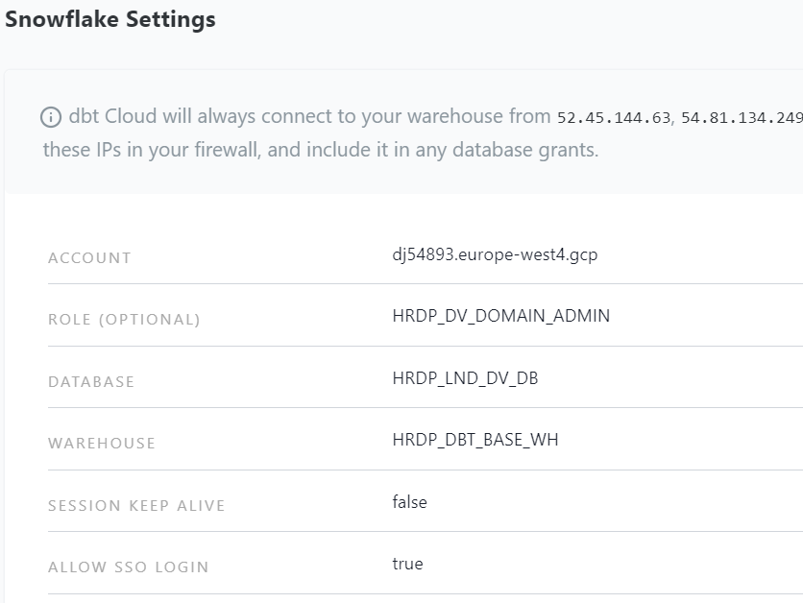
Project Setup
Create a Connection
dbt Cloud uses this connection to connect to your database when running jobs and transformation queries.

Slide 4
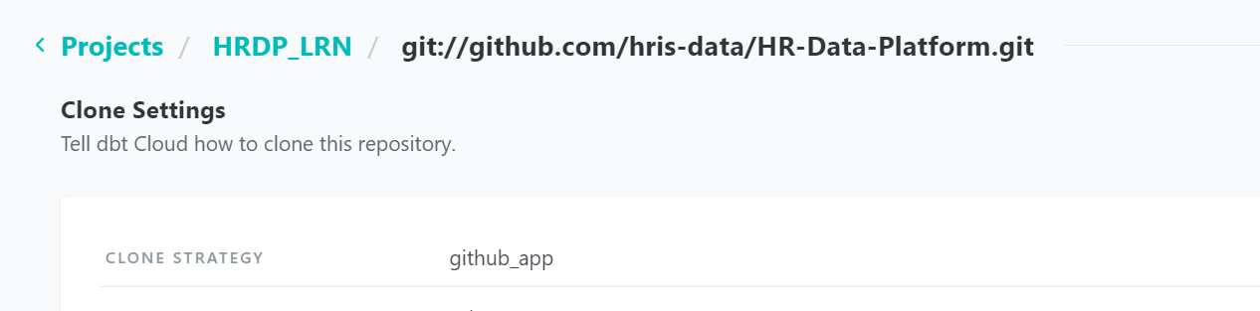
Project Setup cont’d…
Connect a Repository
dbt Cloud plugs directly into your version control system (GitHub, GitLab, BitBucket, etc) to pull the latest version of your dbt project.

Slide 5
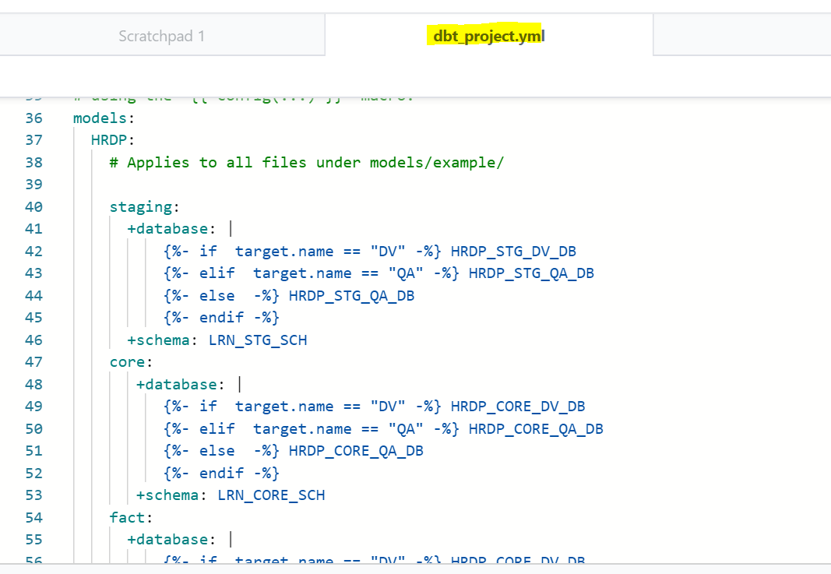
Project YAML
Every dbt project needs a dbt_project.yml file — this is how dbt knows a directory is a dbt project. It also contains important information that tells dbt how to operate on your project.

Slide 6
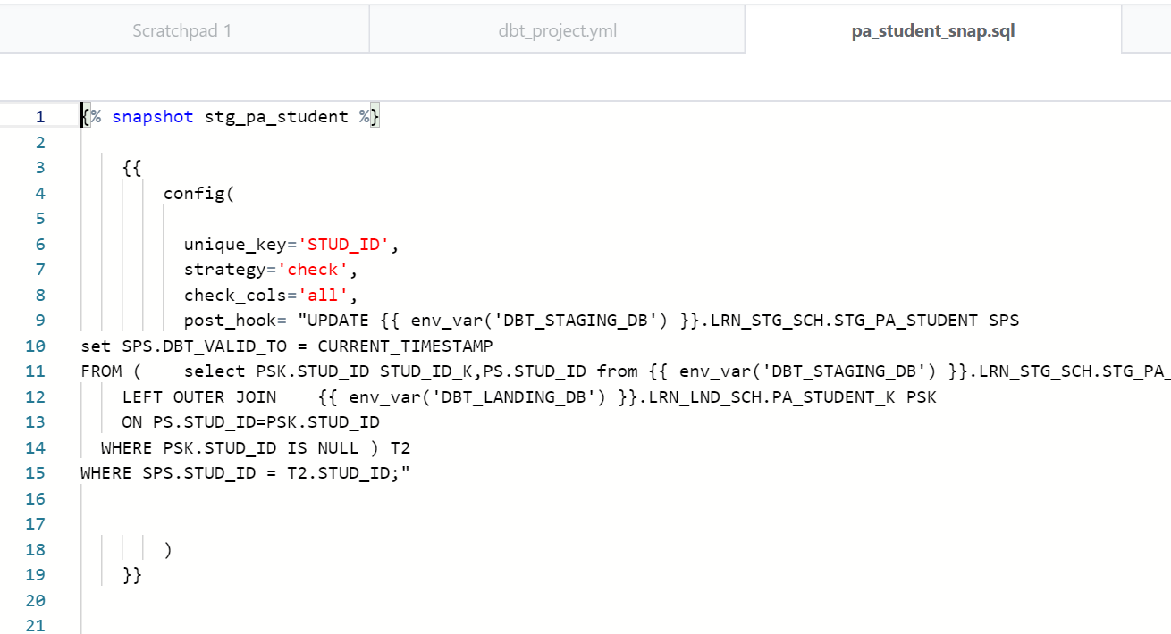
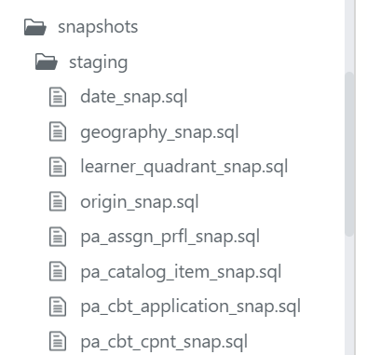
Folder Structure
SNAPSHOT
Snapshot is taken care of SCD Type 2 by having additional audit columns like DBT_VALID_FROM, DBT_VALID_TO
Using this Snapshot, the transformation from landing to staging load is maintained
Landing layers are truncate and load and in staging layer the historical records are available.

Slide 7
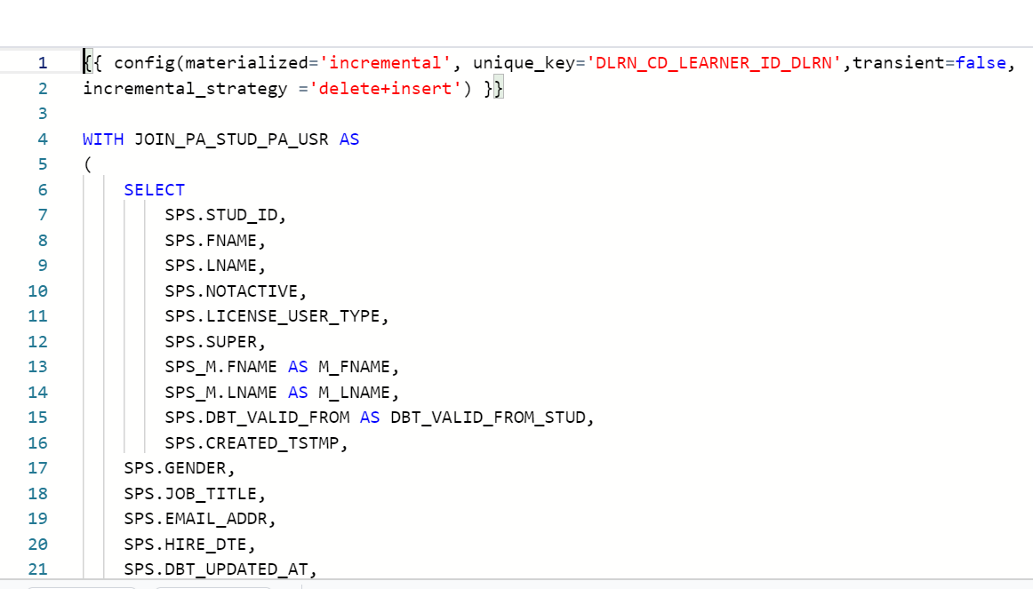
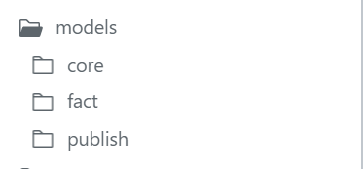
Folder Structure cont’d…
Models
Using Model folder, the transformation from Staging to Core is maintained
In core layer, the flow from staging tables to dimensional tables and dimensional tables to Fact tables are maintained using job dependency.
All the dimensional tables are SCD Type 1 and it is handled by incremental option.

Slide 8
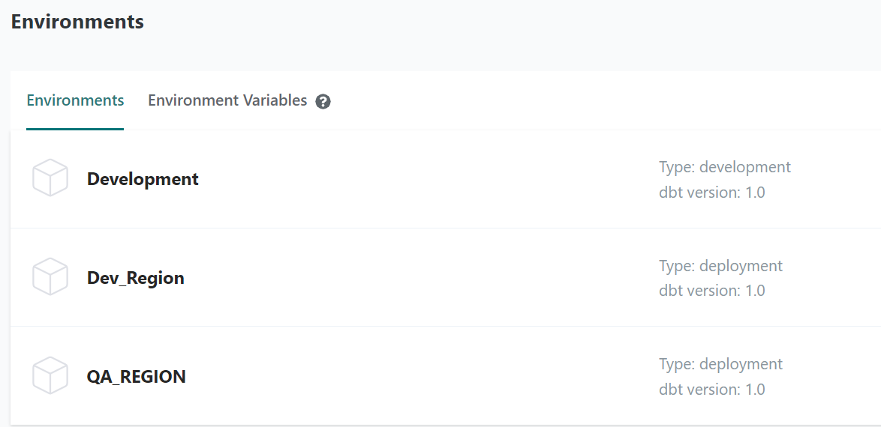
Environments
In software engineering, environments are used to enable engineers to develop and test code without impacting the users of their software.
“Production” (or pd) refers to the environment that end users interact with, while “development” (or dv) is the environment that engineers write code in. This means that engineers can work iteratively when writing and testing new code in development, and once they are confident in these changes, deploy their code to production.

Slide 9
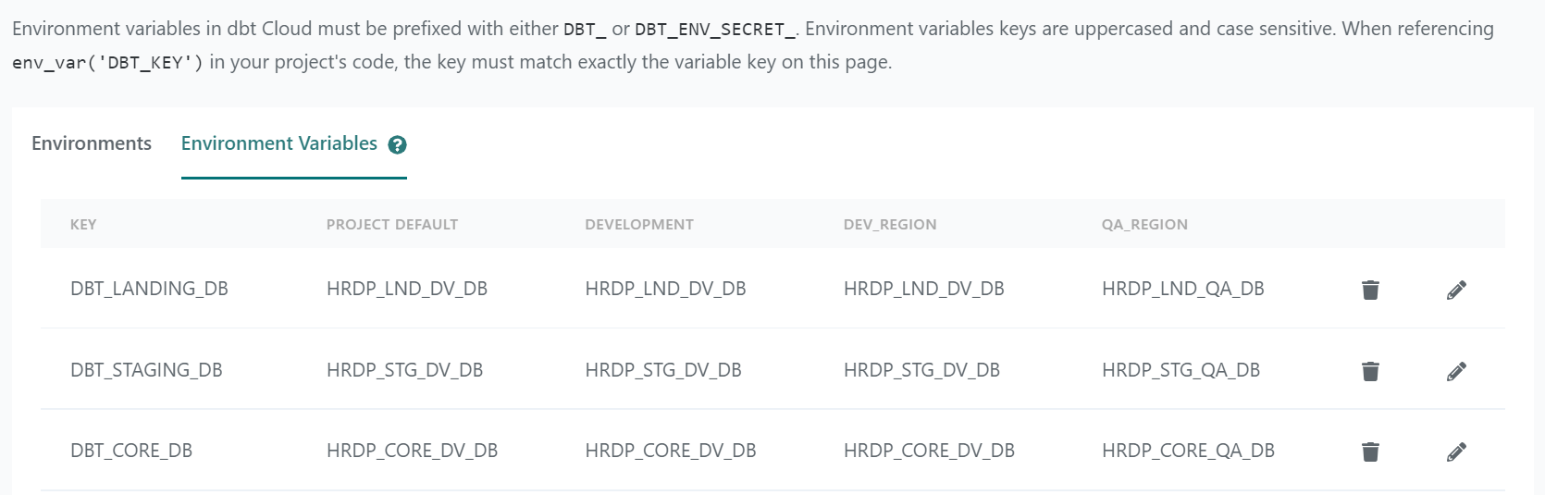
Environment cont’d…
Environment Variables
The env_var function can be used to incorporate Environment Variables from the system into your dbt project.

Slide 10
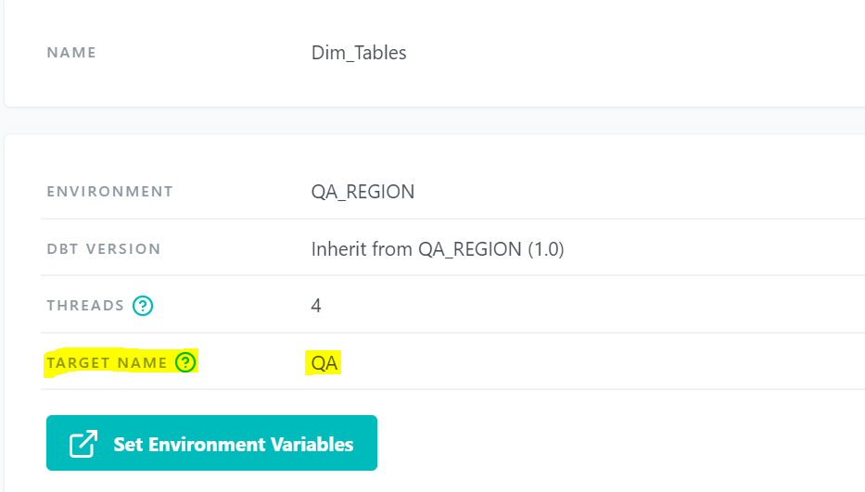
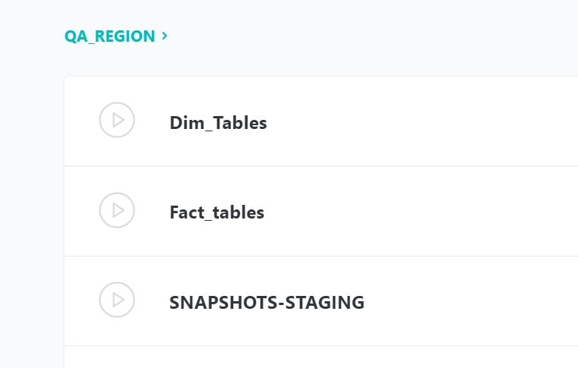
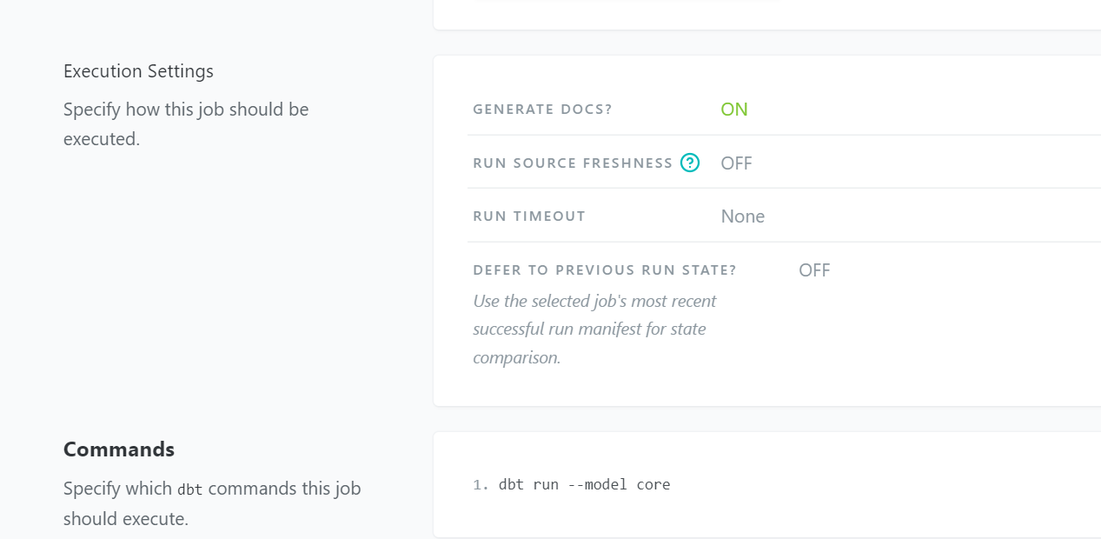
JOBS
Jobs are a set of dbt commands that you want to run on a schedule

Slide 11
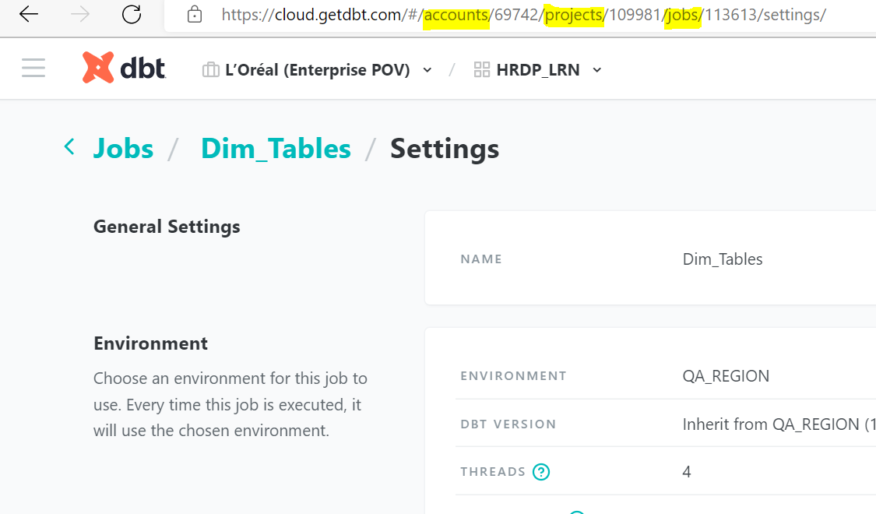
Jobs Cont’d…
The created Jobs are triggering from Apache Airflow using the below ID’s
Account ID
Project ID
Job ID

Slide 12
DBT Flow
Landing
Staging
Core
Publish
Landing data is loaded by python script daily.
DBT starts from extracting the data from Landing layer to Staging Layer using Snapshot option
Once the staging completed successfully the Core layer triggered all the dimensional tables parallelly .
Once the Dimensional Tables completed successfully the Fact tables are triggered in a sequence mode with proper dependency

Slide 13
Q’s for Ernesto
Is there any way we can use snowflake Sequence in DBT. Currently I am using dbt_utils.surrogate key to generate surrogate key.

